Slide 1
Fitness and Nutrition Tracking app
A proposal by Caleb Bergen

Slide 2
What will my app do?
My app will have similar nutrition tracking features similar to other tracking apps, such as MyFitnessPal
I also intend to implement workout planning and tracking as well, similar to apps such as My Workout Plan
What makes mine different? I plan on combining the features of both apps into on comprehensive fitness and nutrition tacking app

Slide 3
Why my app?
Having both fitness and nutrition tracking capabilities in one app provides users with the most convenient and streamlined experience possible
There is also the possibility for interaction between the two tracking modes.
For example, the app has the potential to more accurately calculate daily caloric intake based off a user's exercise

Slide 4
Additional technologies
I plan on implementing an API to allow users to scan the barcode of a food and automatically enter the nutrients into the app. There are several different APIs that serve this purpose, I have yet to decide on the specific API yet.
I hope to implement the FitBit API for automatic exercise tracking
I may also use the the wger Workout Manager API to allow users automatically calculate the caloric burn of certain exercises

Slide 5
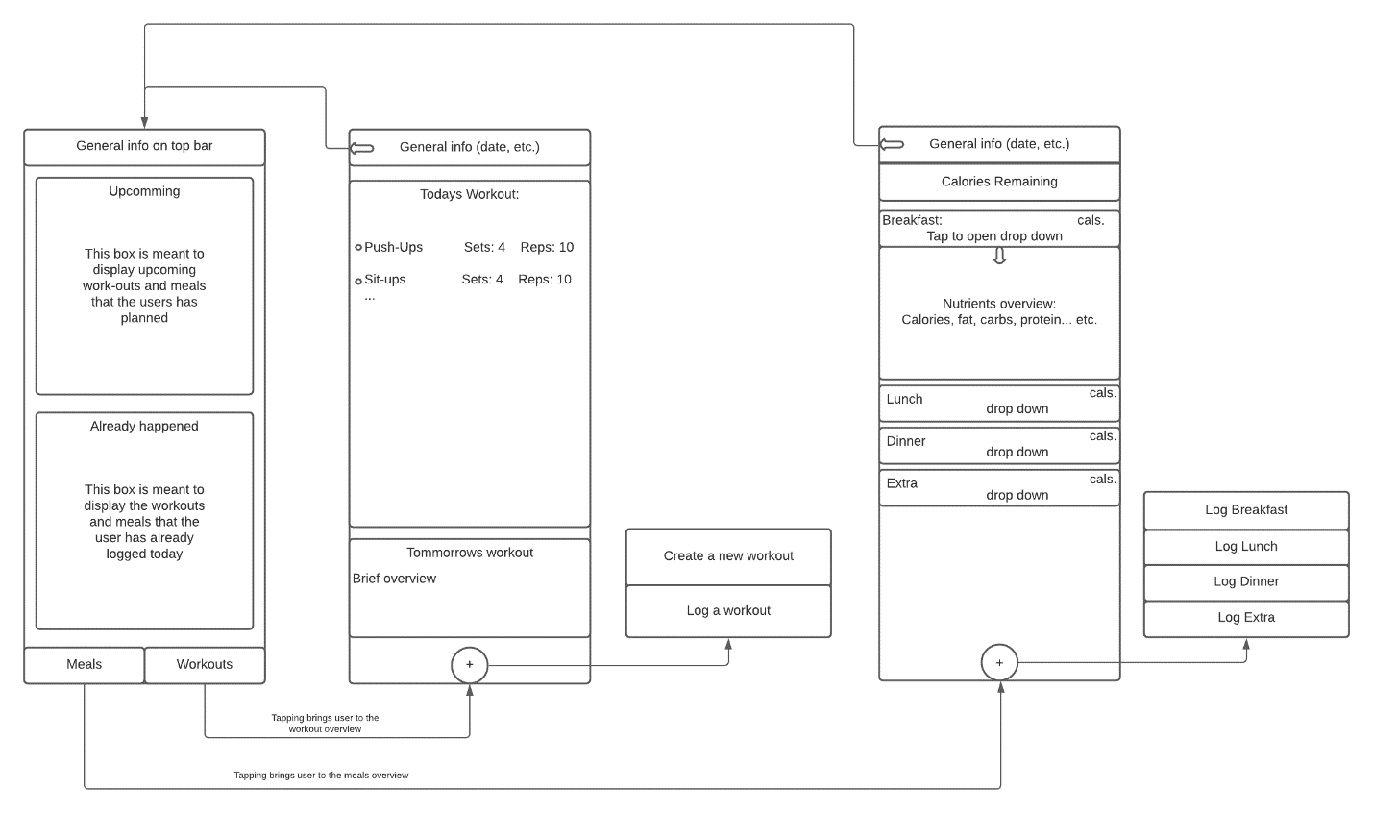
UI diagram

Slide 6
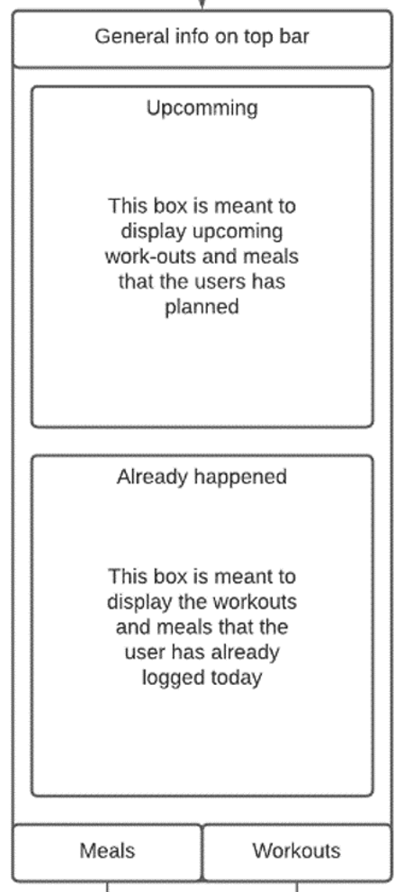
Main Screen
General info such as date, time, and calories remaining displayed on top bar
The general bar will be displayed across all menus
Upcoming meals and workouts in upcoming section
A summary of the day so far in the already happened section
Two tabs at the bottom to take the user to the dedicated meals and workout screens

Slide 7
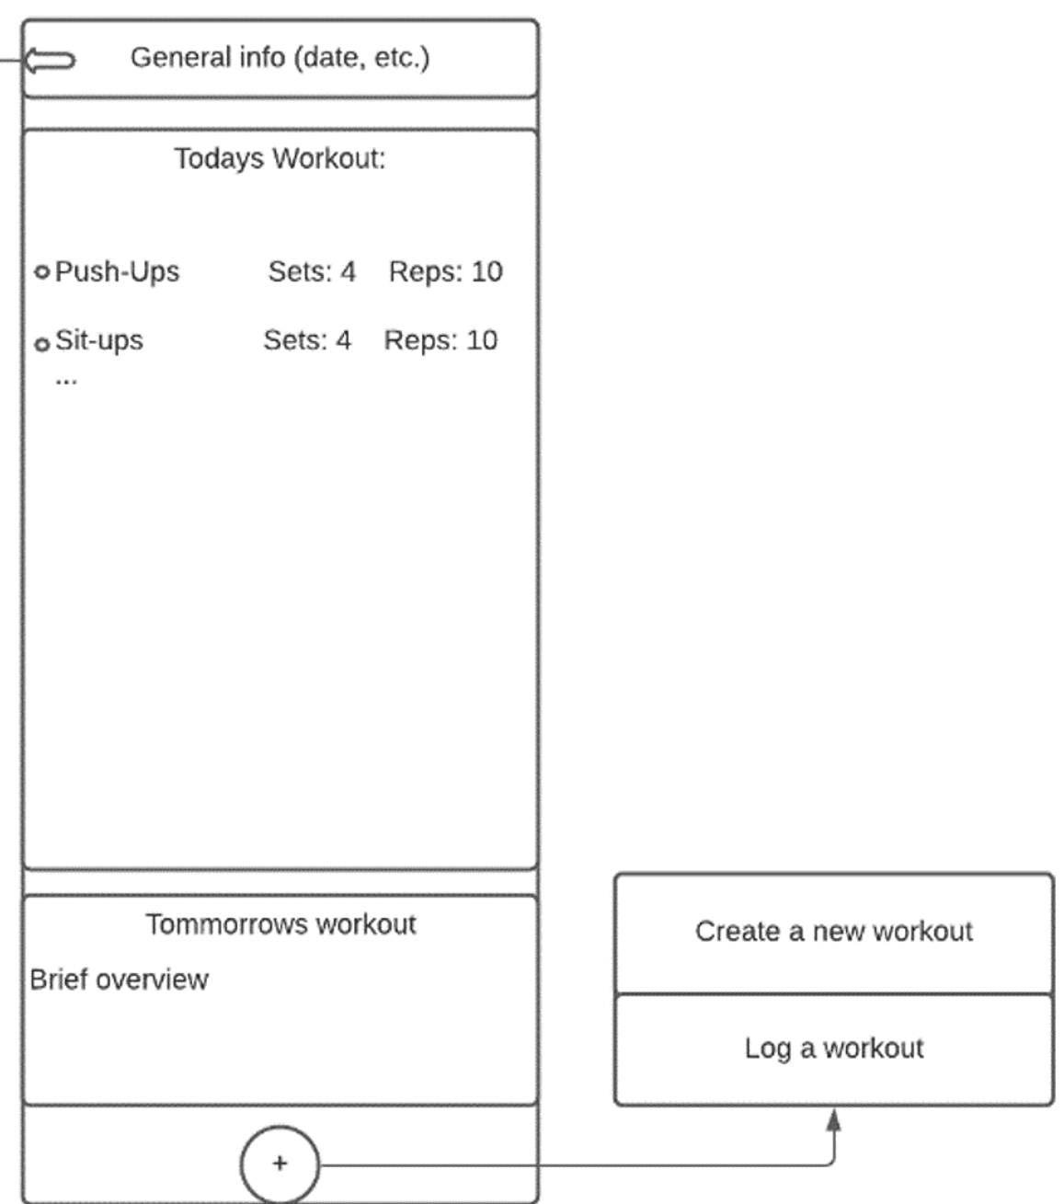
Work-Out screen
General info still displayed
The todays workout section will display the upcoming workouts for the day
The tomorrow's workout section will display a brief overview of upcoming workouts
The + button will bring up a submenu that allows users to create or schedule a new workout or log a workout

Slide 8
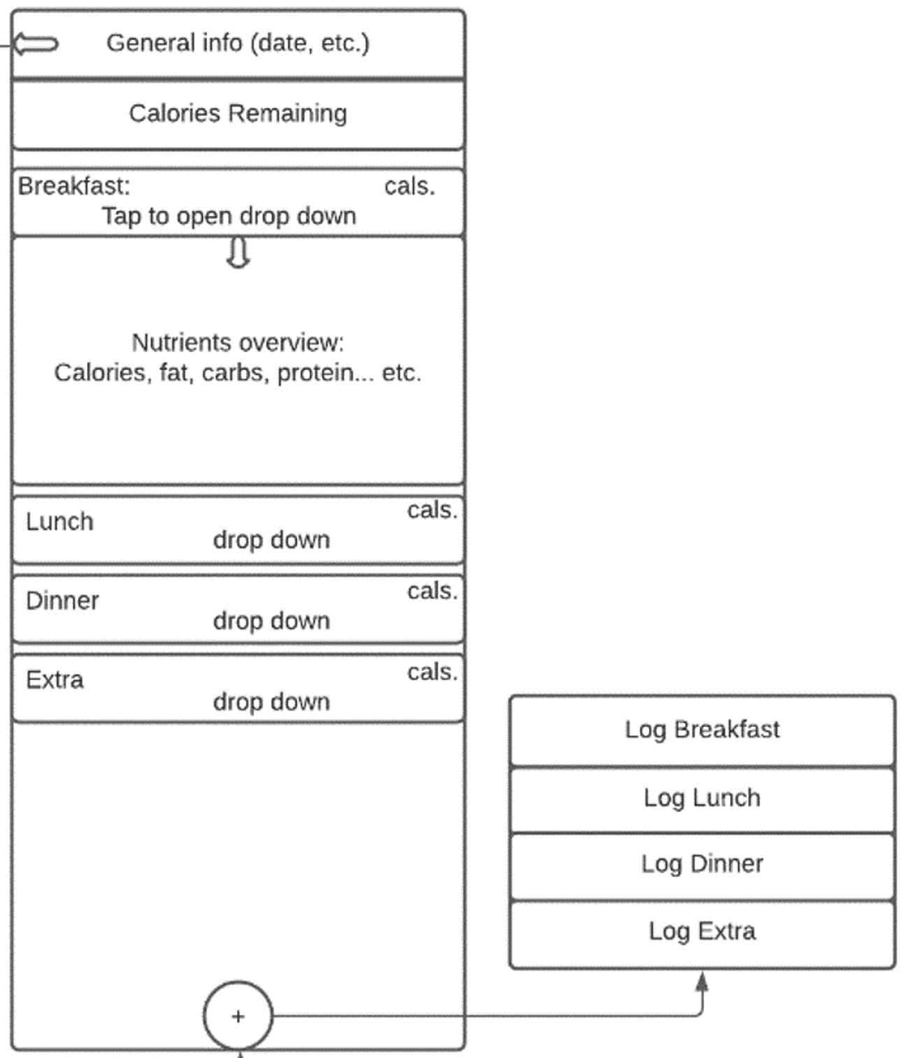
Nutrition screen
General info still displayed
Below general info there will be a break down of the days remaining calories
Each mealtime will have an overview that users can tap on to get a break down.
Users can either swipe left or right on a meal time to log a new meal or press on the + button.
The + button brings up a sub menu that allows users to log or plan a new meal

